Slide 1
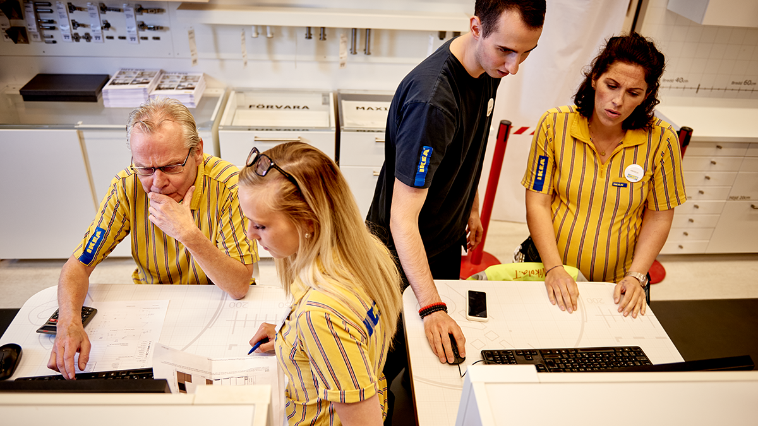
Storytelling workshop March 2025
Notes:
Great presentations: it’s not only about visualizations and design, but it’s the story you tell
In this workshop we will show you how to turn your presentation into a story with:
Clear takeaways
Compelling insights
Engaging narrative
We will go through the steps of the storytelling process in detail and we will work on some real world examples

Slide 2


Slide 3
Introduction
How to tell a story
When building a presentation, you have one primary goal: to make it as easy as possible for the audience to understand what you are trying to tell them
Business presentations tend to have a lot of data and information, which makes it difficult for the audience to grasp the key insights
How can you structure your deck such that it is clear, insightful and engaging?
By using two important concepts:
SCQA Framework
Pyramid Principle
Notes:
- You don’t always have to use these frameworks!

Slide 4

SCQA Framework

Slide 5
Situation
Complication
Question
Answer

Slide 6
Situation
Should we add this new payment method?
How did this marketing campaign perform?
Complication
Question
What did you find in your research?
Answer

Slide 7
Situation
Complication
Question
Answer
Introduction
Main Deck
Notes:
Main deck is used to answer the question
SCQ are how you provide context to that answer
As analysts we often have the tendency to skip the context and jump right into the Answer (or maybe the Question)
Sometimes we don’t even know the context
Or we are so deep into the topic that we just forget about it
Think about your audience: how much do they already know? A little recap is (almost) always helpful

Slide 8
Situation
How things are right now
Complication
A change in the situation (why presentation is needed)
Question
What gets raised by the complication
Answer
Resolution to the question

Slide 9
Situation
IKEA is looking to grow revenue in Sweden with a new store
Complication
However, we still need to decide where to open the new store
Question
Where should IKEA open its new store?
Answer
IKEA should open its new store in ___________

Slide 10
IKEA is looking to grow revenue with a new store
We need to decide where to open the new store
Where should IKEA open its new store?
IKEA should open its new store in ___________
Introduction
Main Deck
Notes:
Notice how this brings the presentation to life: It puts the presentation in context, and it tells the audience why they should care
Instead of just dropping them in the middle of your data, you’re leading them along and creating a narrative
Remember your goal is to make it as easy as possible for the audience to understand what you are trying to tell them

Slide 11
Introduction
How to tell a story
When building a presentation, you have one primary goal: to make it as easy as possible for the audience to understand what you are trying to tell them
Business presentations tend to have a lot of data and information, which makes it difficult for the audience to grasp the key insights
How can you structure your deck such that it is clear, insightful and engaging?
By using two important concepts:
SCQA Framework
Pyramid Principle

Slide 12
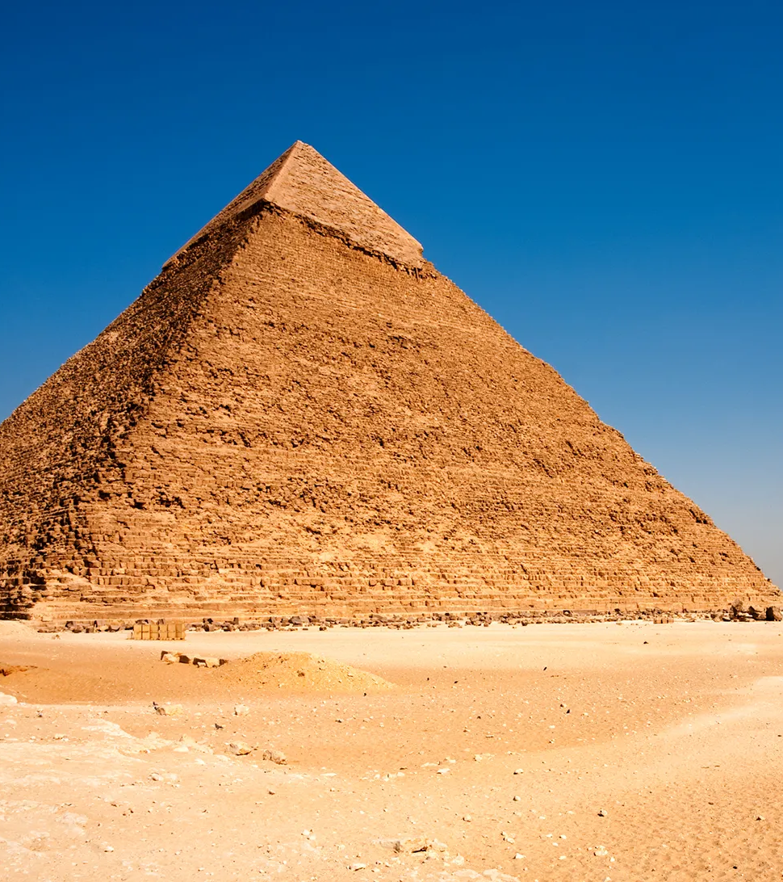
Pyramid principle

Slide 13
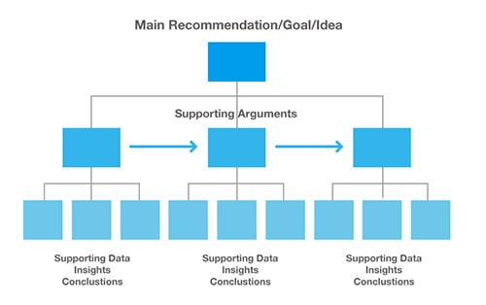
The pyramid principle is an effective way of communicating information
What should we do?
MECE arguments
Evidence
Notes:
Summary: prime your audience >> very different from academia!!
Main message is the summarized Answer from the previous part
MECE : mutually exclusive, collectively exhaustive. Meaning, no overlap, covering everything
Evidence: think of visualization workshop. Only keep what is supporting the argument, headers should tell a convincing story

Slide 14
Where should Disney build a new theme park?
Pyramid principle based solution to the question
Disney should open a theme park in Rio
1
2
Rio is a major tourist destination
Disney brand is strong in Brazil
1.1
1.2
2.1
2.2
2M foreign tourists visit per year
3M Brazilian tourists visit per year
1/3 of Brazilians that travel in the US visit Disney World
Disney movies are popular in Brazil
Notes:
Ideally you would have 3 (or 4) supporting arguments. With 2, if one gets challenged, you only have one left

Slide 15
Where should Disney build a new theme park?
From pyramid principle to presentation order
SCQ
Disney should open a theme park in Rio
Rio is a major tourist destination
Disney brand is strong in Brazil
1
2
1
1.1
1.2
Rio is a major tourist destination
2M foreign tourists visit per year
3M Brazilian tourists visit per year
2
2.1
2.2
Disney brand is strong in Brazil
1/3 of Brazilians that travel in the US visit Disney World
Disney movies are popular in Brazil
Notes:
These are the titles of your slides

Slide 16
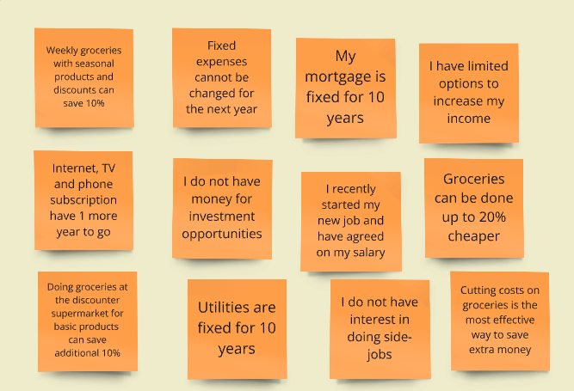
Exercise: reshuffle the cards into a pyramid
Notes:
Story telling exercise, Online Whiteboard for Visual Collaboration (miro.com)

Slide 17
Exercise: reshuffle the cards into a pyramid
Cutting costs on groceries is the most effective way to save extra money
I have limited options to increase my income
Fixed expenses cannot be changed for the next year
Groceries can be done up to 20% cheaper
I recently started my new job, and have agreed on my salary
My mortgage is fixed for 10 years
Weekly groceries with seasonal products and discounts can save 10%
I do not have interest in doing side-jobs
Utilities are fixed for 2 more years
Doing groceries at the discounter supermarket for basic products can save additional 10%
I do not have money for investment opportunities
Internet, TV and phone have 1 more year to go

Slide 18
Visualization workshop March 2025

Slide 19
Data analytics workflow
1. Define the question
2. Collect the relevant data
3. Clean the data
4. Analyze the data
5. Visualize and interpret
6. Communicate results
Continuous feedback
Understand the business problem by asking the right questions.
Formulate hyptheses and data need.
Think about (or sketch) the resulting slides/product/message. What does it look like in a graph?
Collect only data necessary to confirm your hypotheses.
Check for data completeness, outliers, duplicates etc.
Obtain a thorough understanding of the data.
Confirm/reject your hypotheses.
Fill in the numbers in the end product you thought of in step 1.
How does it answer your business question?
Follow visualization guidelines
Convey main message.
Discuss results with stakeholders.

Slide 20
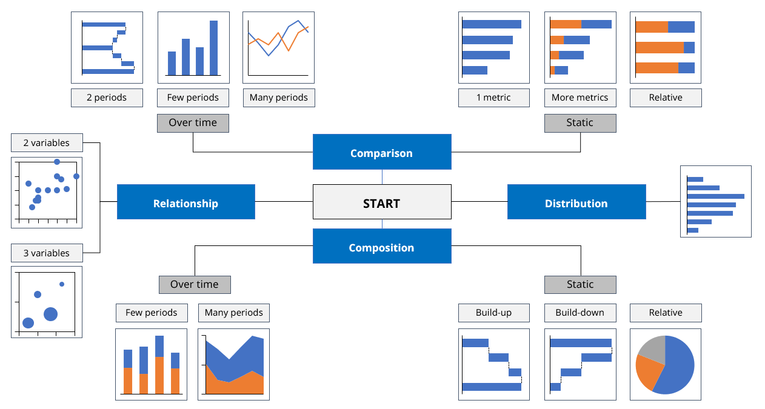
Visualization Checklist
Are your visualizations supporting the message? Or distracting from it? (Where is Waldo?)
Is your slide stripped of all redundant information?
Information processing
Graphs
Did you use graphs instead of tables or text?
Did you follow the rules?
Natural reading order: top-down, left to right
X-axis for time, Y-axis for everything else
No line in a graph if the information is not continuous
Logical start- and endpoint of your graphs (i.e. pie charts start at 12 o’clock)
Does the graph visualize the message?
Is the message supported by number(s) and can these number(s) directly be found on the slide?
Did you use the right graph?
Does the graph have a title?
Is clear for each component of
the graph which value is
represented (€, #, $, etc)?
Slide Design
Are the objects properly aligned and distributed? Both mutually and on the slide?
Are you consistent with font type, size, shape and color? Use font Noto IKEA Latin 12
Did you avoid too large font sizes and bright colors?
Did you use the IKEA template?
Is the color association correct (red = bad, green = good?
Is your slide peaceful and orderly?
Notes:
Some of this is my personal preference
There should always be room for your own personal preferences and creativity
These are more guidelines than rules

Slide 21
Visualization Checklist
Are your visualizations supporting the message? Or distracting from it? (Where is Waldo?)
Is your slide stripped of all redundant information?
Information processing
Graphs
Did you use graphs instead of tables or text?
Did you follow the rules?
Natural reading order: top-down, left to right
X-axis for time, Y-axis for everything else
No line in a graph if the information is not continuous
Logical start- and endpoint of your graphs (i.e. pie charts start at 12 o’clock)
Does the graph visualize the message?
Is the message supported by number(s) and can these number(s) directly be found on the slide?
Did you use the right graph?
Does the graph have a title?
Is clear for each component of
the graph which value is
represented (€, #, $, etc)?
Slide Design
Are the objects properly aligned and distributed? Both mutually and on the slide?
Are you consistent with font type, size, shape and color? Use font Noto IKEA Latin 12
Did you avoid too large font sizes and bright colors?
Did you use the IKEA template?
Is the color association correct (red = bad, green = good?
Is your slide peaceful and orderly?

Slide 22
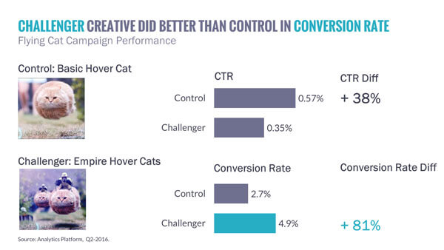
What is wrong with this slide?

Slide 23
A lot…
If conversion rate is the most important metric, it should be shown on top
The placement of the pictures is confusing
I would rather use percentage points differences
I don’t like highlighting in titles
The wording “did better” is vague

Slide 24
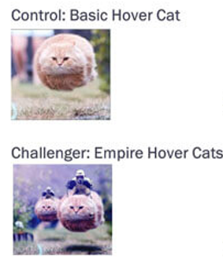
Is this better?
Challenger had 2.2% higher conversion rate then control
Conversion rate
Challenger
4.9%
+2.2%
Control
2.7%
CTR
Challenger
0.35%
-0.22%
Control
0.57%

Slide 25
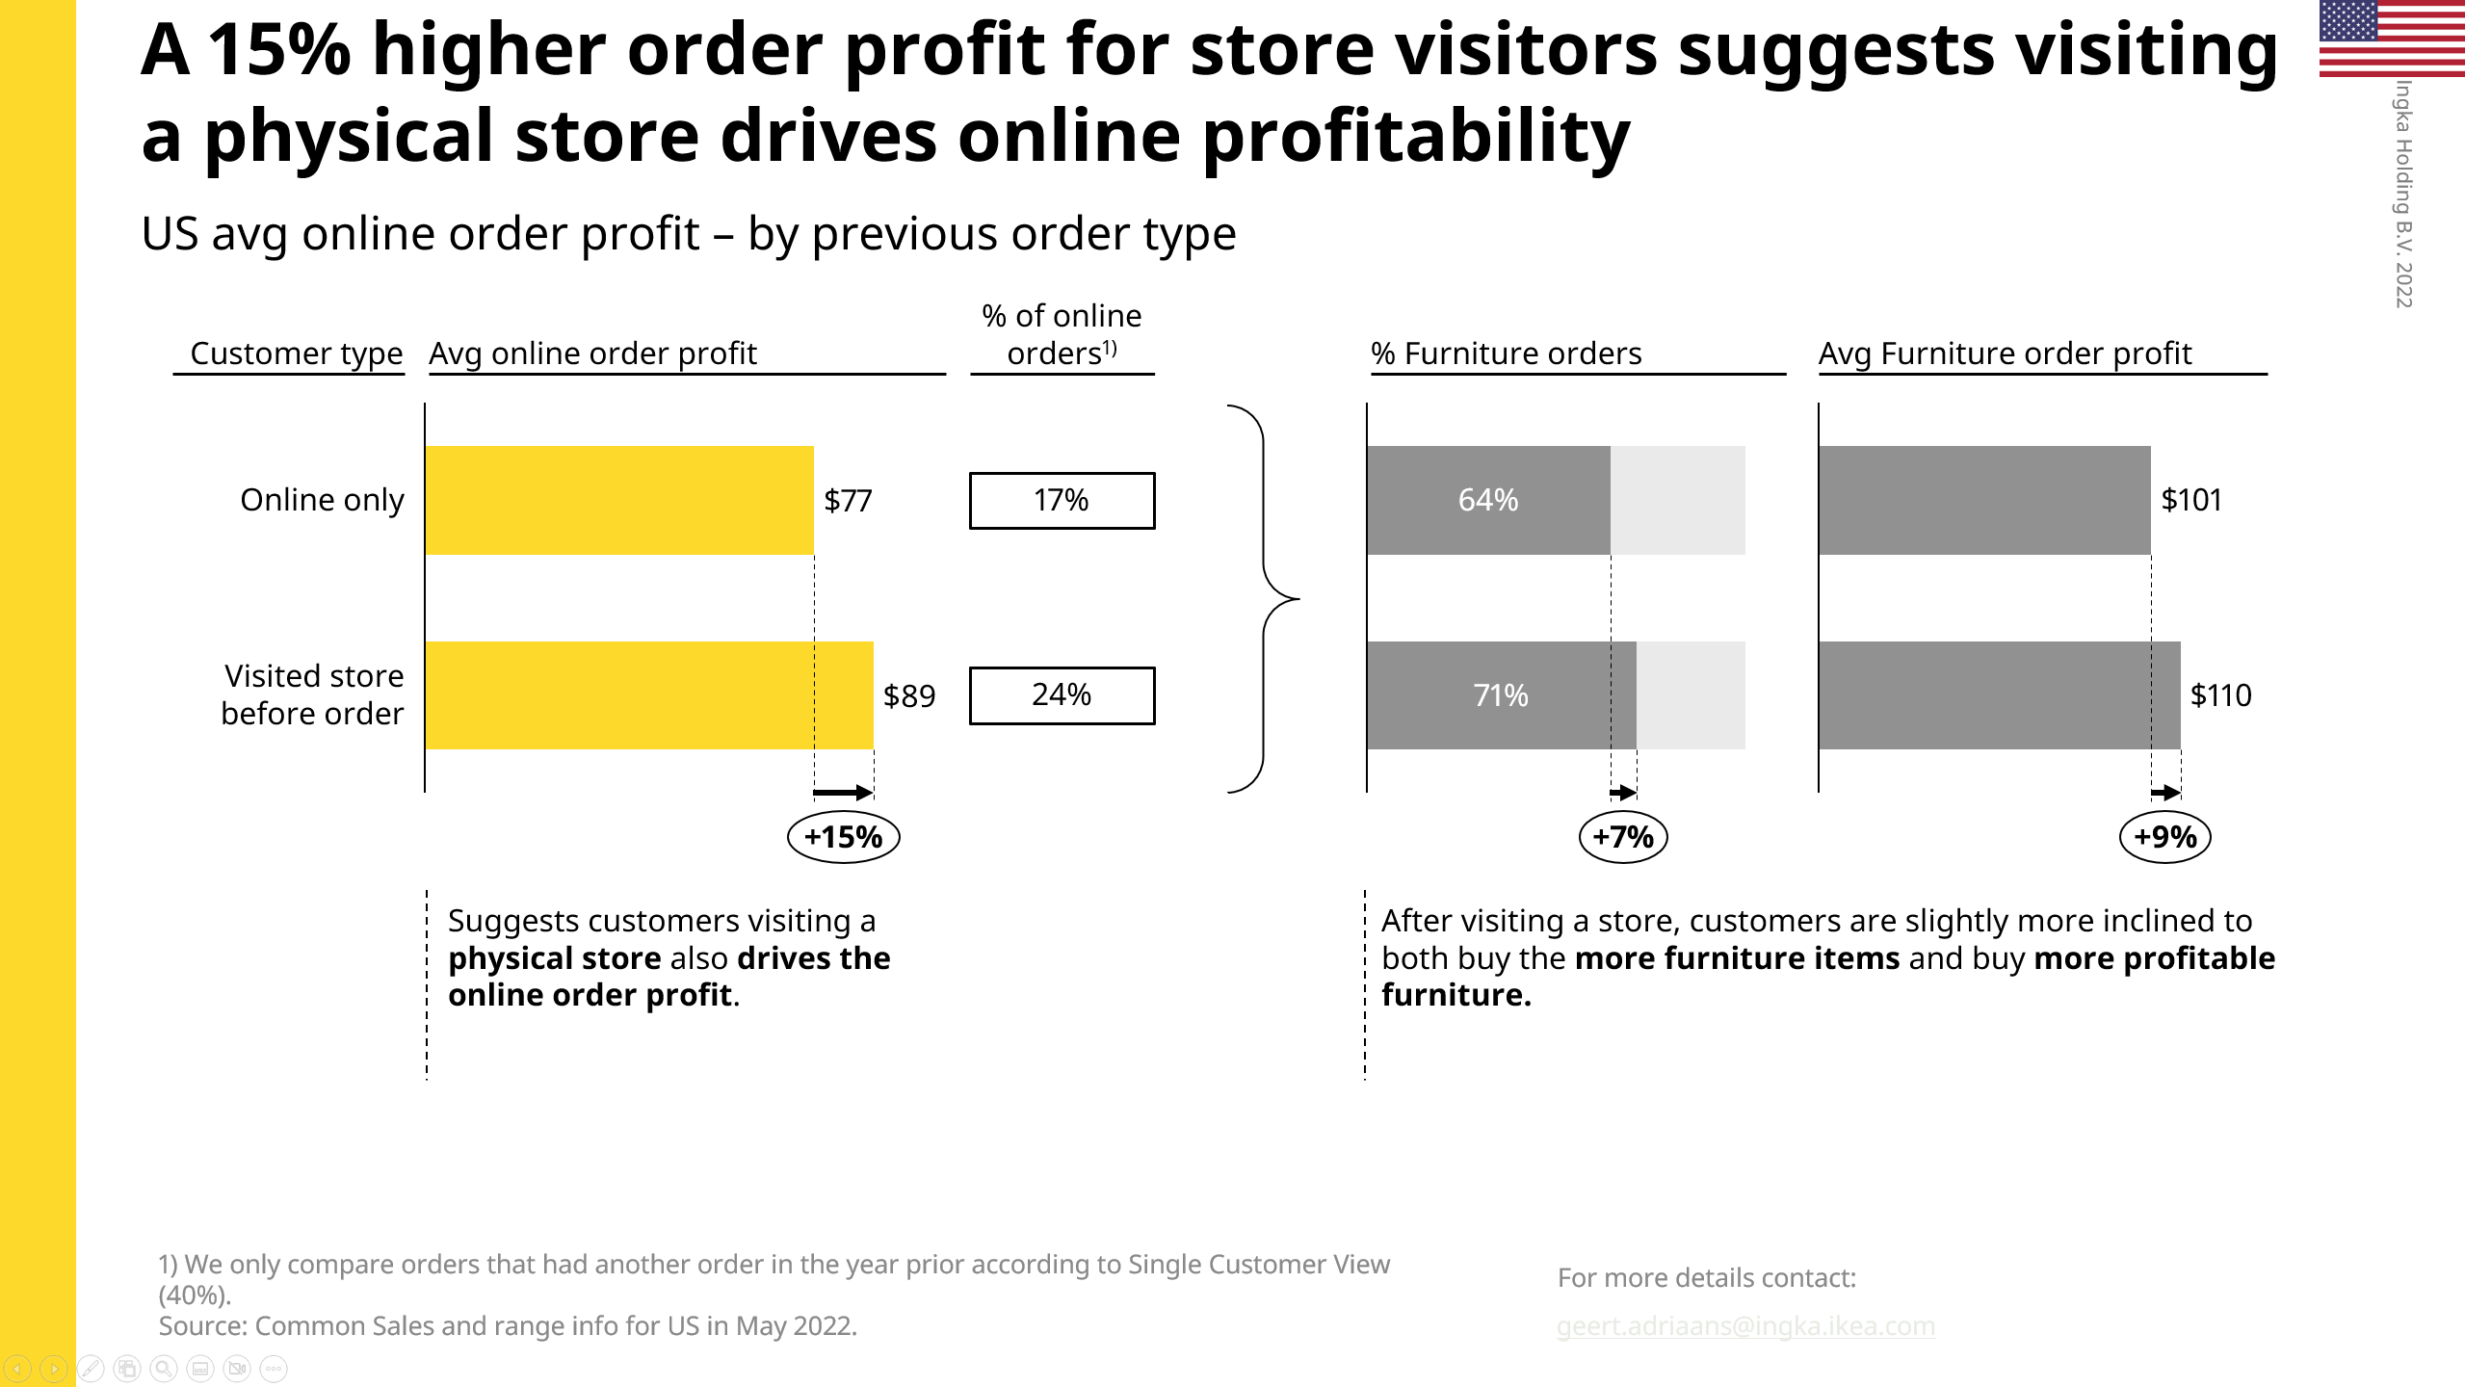
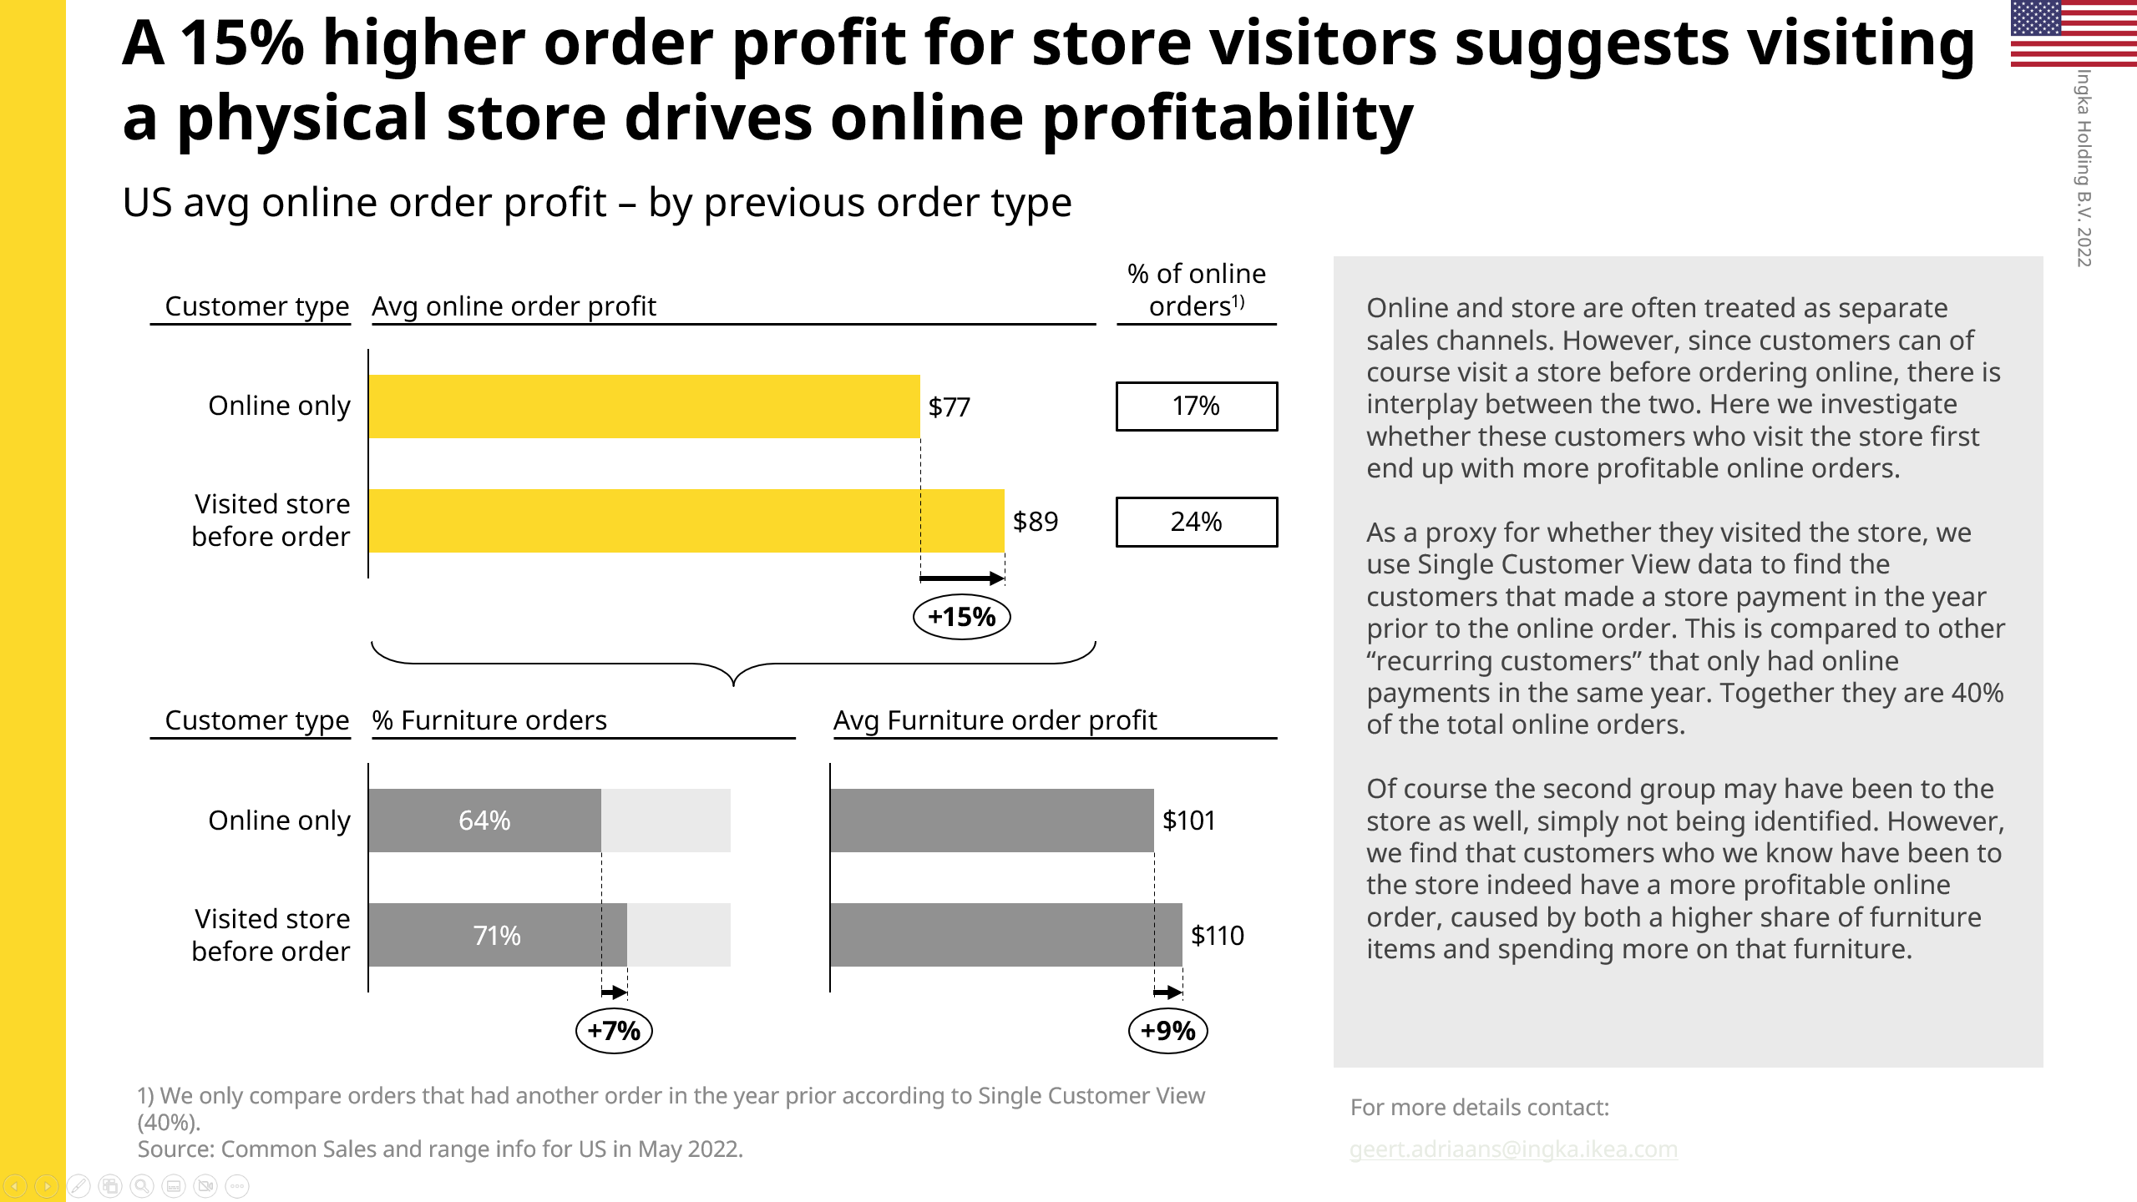
Structure your analytical slides according to their purpose
Slide suitable for presentation
Slide meant to be read
Limited amount of text on slide to not distract the audience
Since you are not always there to explain the slide, you set the context in the textbox on the right
Apart from how you use the text on slide, similar guidelines to slide design apply!

Slide 26

Online order profit is 15% higher when customers have visited a store before
The title is active and precise, states the main conclusion and is supported by the visualization
US avg online order profit – by previous order type
Subtitle factually describes the visual
Graph has headers
Online and store are often treated as separate sales channels. However, since customers can of course visit a store before ordering online, there is interplay between the two. Here we investigate whether these customers who visit the store first end up with more profitable online orders.
As a proxy for whether they visited the store, we use Single Customer View data to find the customers that made a store payment in the year prior to the online order. This is compared to other “recurring customers” that only had online payments in the same year. Together they are 40% of the total online orders.
Of course, the second group may have been to the store as well, simply not being identified. However, we find that customers who we know have been to the store indeed have a more profitable online order, caused by both a higher share of furniture items and spending more on that furniture.
Customer type
Average online order profit
Online only
One clear visualization that directly supports the conclusion; no redundant information
Visited store before order
The text box is used to provide context for people reading the slide
Numbers in the title can be found on the slide
+15%
Suggests customers visiting a physical store also drives the online order profit.
Source and additional comments in footnote
1) We only compare orders that had another order in the year prior according to Single Customer View (40%).
Source: Common Sales and range info for US in May 2022.
Geert.Adriaans@ingka.ikea.com

Slide 27
Visualization Checklist
Are your visualizations supporting the message? Or distracting from it? (Where is Waldo?)
Is your slide stripped of all redundant information?
Information processing
Graphs
Did you use graphs instead of tables or text?
Did you follow the rules?
Natural reading order: top-down, left to right
X-axis for time, Y-axis for everything else
No line in a graph if the information is not continuous
Logical start- and endpoint of your graphs (i.e. pie charts start at 12 o’clock)
Does the graph visualize the message?
Is the message supported by number(s) and can these number(s) directly be found on the slide?
Did you use the right graph?
Does the graph have a title?
Is clear for each component of
the graph which value is
represented (€, #, $, etc)?
Slide Design
Are the objects properly aligned and distributed? Both mutually and on the slide?
Are you consistent with font type, size, shape and color? Use font Noto IKEA Latin 12
Did you avoid too large font sizes and bright colors?
Did you use the IKEA template?
Is the color association correct (red = bad, green = good?
Is your slide peaceful and orderly?

Slide 28
2 periods
Few periods
Many periods
1 metric
More metrics
Relative
Over time
Static
2 variables
Comparison
Relationship
START
Distribution
Composition
3 variables
Over time
Static
Few periods
Many periods
Build-up
Build-down
Relative
Notes:
Horizontal for time
Lines when you have too many bars
Distribution has a natural order, no need to sort it
Build-down can be used to go from revenues to profit
Pie charts are forbidden

Slide 29
Following the rules: an example (1/6)
USD (millions)
Explanation of graph:
Accounting: 1,0 million USD
HR: 2,0 million USD
Management: 3,4 million USD
R&D: 2,9 million USD
Sales: 7,2 million USD
Accounting
HR
Management
R&D
Sales
YTD Expenses by Department

Slide 30
Following the rules: an example (2/6)
YTD Expenses by Department
USD (millions)
Graph and axis title added
Accounting
HR
Management
R&D
Sales

Slide 31
Following the rules: an example (3/6)
YTD Expenses by Department
USD (millions)
Changed from line to bar chart, because the data is not continuous
Accounting
HR
Management
R&D
Sales

Slide 32
Following the rules: an example (4/6)
YTD Expenses by Department
Accounting
Put categories on the vertical axis, because they are not related to time
HR
Management
R&D
Sales
USD (millions)

Slide 33
Following the rules: an example (5/6)
YTD Expenses by Department
(in USD millions)
Department
Sales
Created separate headers for categories and values
Sorted departments based on YTD expenses
Management
R&D
HR
Accounting
Removed horizontal axis and tick marks

Slide 34
Following the rules: an example (6/6)
YTD Expenses by Department
(in USD millions)
Department
Sales
Highlighted the department with the highest value (optional)
Management
R&D
HR
Accounting

Slide 35
Visualization Checklist
Are your visualizations supporting the message? Or distracting from it? (Where is Waldo?)
Is your slide stripped of all redundant information?
Information processing
Graphs
Did you use graphs instead of tables or text?
Did you follow the rules?
Natural reading order: top-down, left to right
X-axis for time, Y-axis for everything else
No line in a graph if the information is not continuous
Logical start- and endpoint of your graphs (i.e. pie charts start at 12 o’clock)
Does the graph visualize the message?
Is the message supported by number(s) and can these number(s) directly be found on the slide?
Did you use the right graph?
Does the graph have a title?
Is clear for each component of
the graph which value is
represented (€, #, $, etc)?
Are the objects properly aligned and distributed? Both mutually and on the slide?
Are you consistent with font type, size, shape and color? Use font Noto IKEA Latin 12
Did you avoid too large font sizes and bright colors?
Did you use the IKEA template?
Is the color association correct (red = bad, green = good?
Is your slide peaceful and orderly?
Slide Design

Slide 36
Few extra tips for a presentation to be kinder to the eye (1/2)
Explanation
Don’t
Do
Minimize black text on white background
Mix in a little color on the background and use dark grey
Especially for documents that people read on their screen
Black on white gives high contrast and is not soft on the eye
Use mild colors
This holds for graphs, shapes, text, icons…
Mild colors have RBY-values relatively close to each other
22
31
46
Use Sans Serif fonts
Especially for documents that people read on beamers or on their own screen instead of print
Don’t use serif fonts such as Times New Roman, Garamond, Courier New and Cambria
Use as few sharp black lines as possible
This does not only hold for tables, but also for shapes, arrows, etc.
Use grey lines and filling instead
Heavy | 1 | 2
On the | 10% | 15%
Eye | 5% | 18%
Do not maximize font size
It is easier on the eye to read text in font size 10 with blank space around than huge letters
I love
screaming

Slide 37

Few extra tips for a presentation to be kinder to the eye (2/2)
Explanation
Don’t
Do
Use one font size
Few exceptions:
The slide’s title
Footnotes
Text as an object
To emphasize titles, use bold or italics
Outlining and distributing
Within figures one creates peace through outlining and distributing evenly
Also between two different figures one needs same design
Try to extend this to different slides as well
Age
Statistic 1
< 25
41%
25 - 55
96%
> 55
12%
Hair
Statistic 2
Blonde
32%
Brown
74%
Zebra stripes
Especially for documents that people read on beamers or on their own screen instead of print
Initiative
Remarks
Initiative 1
Blablablablablabla
Initiative 2
Blablablablablabla
Initiative 3
Blablablablablabla
Initiative 4
Blablablablablabla

Slide 38
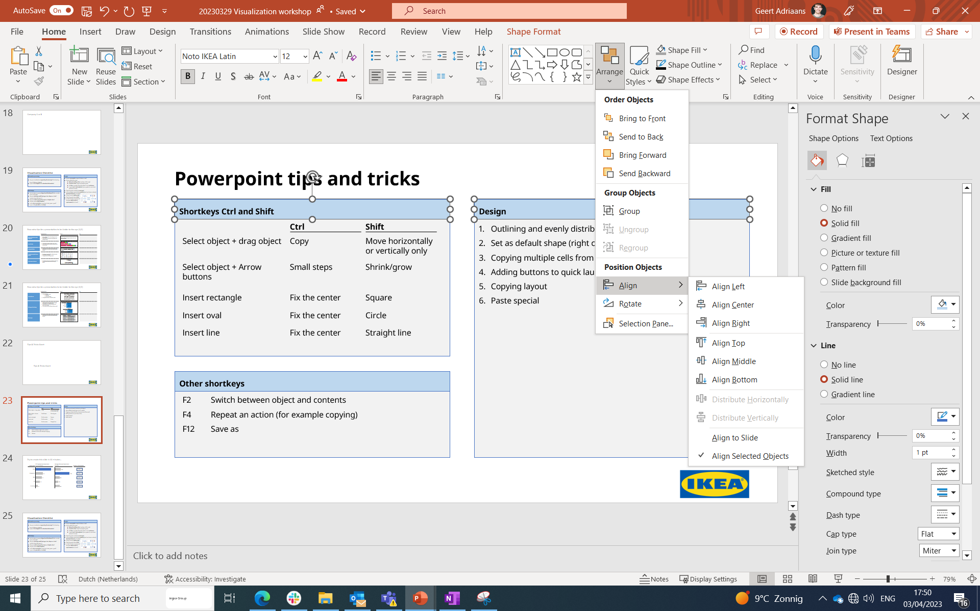
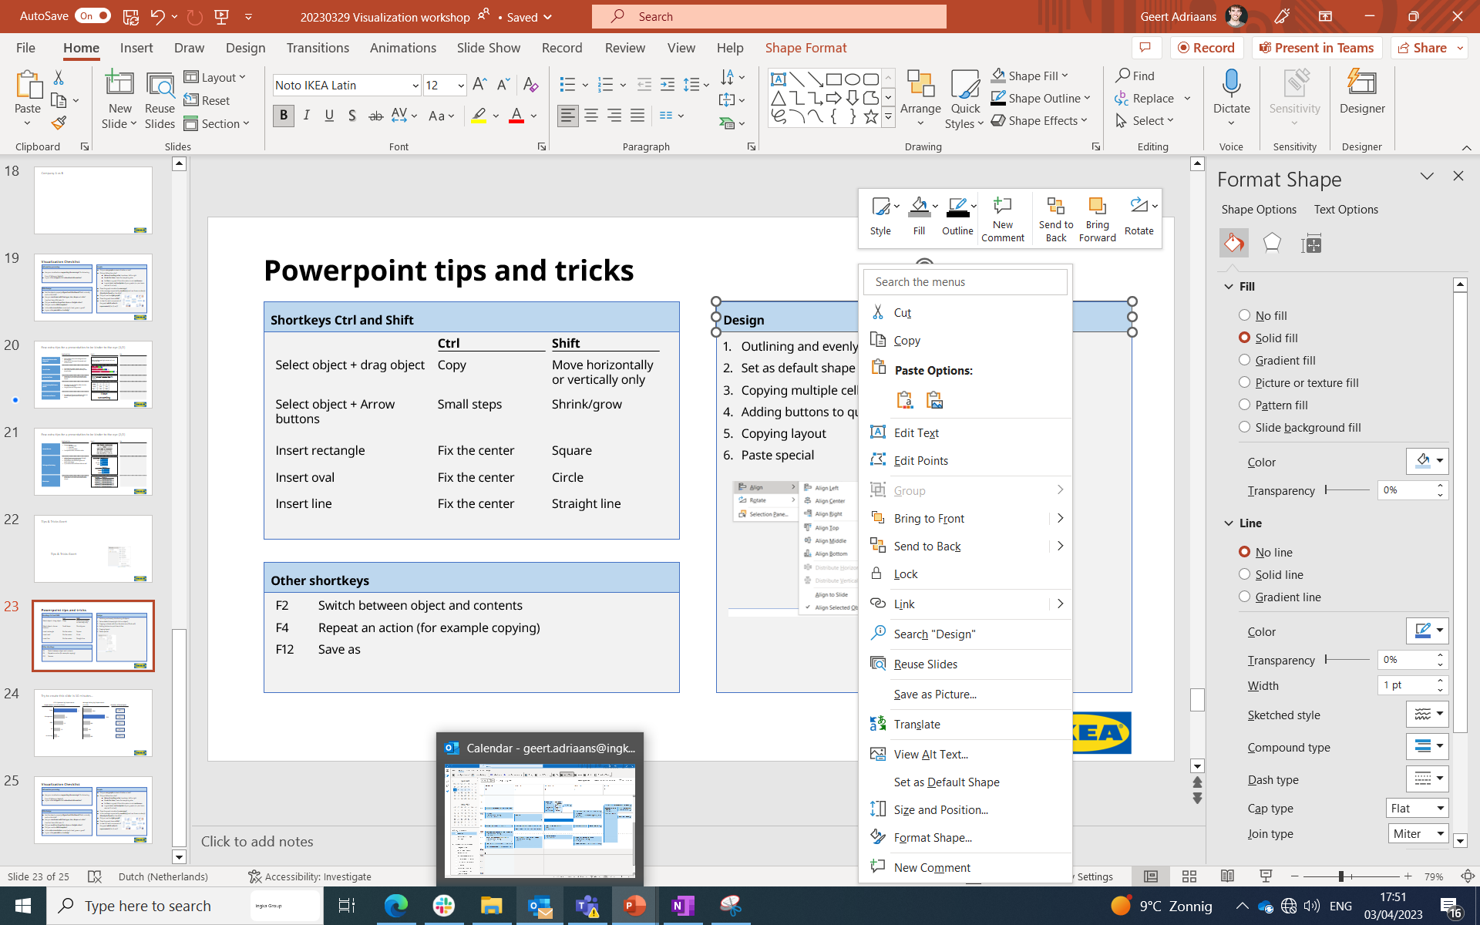
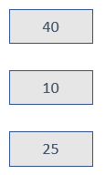

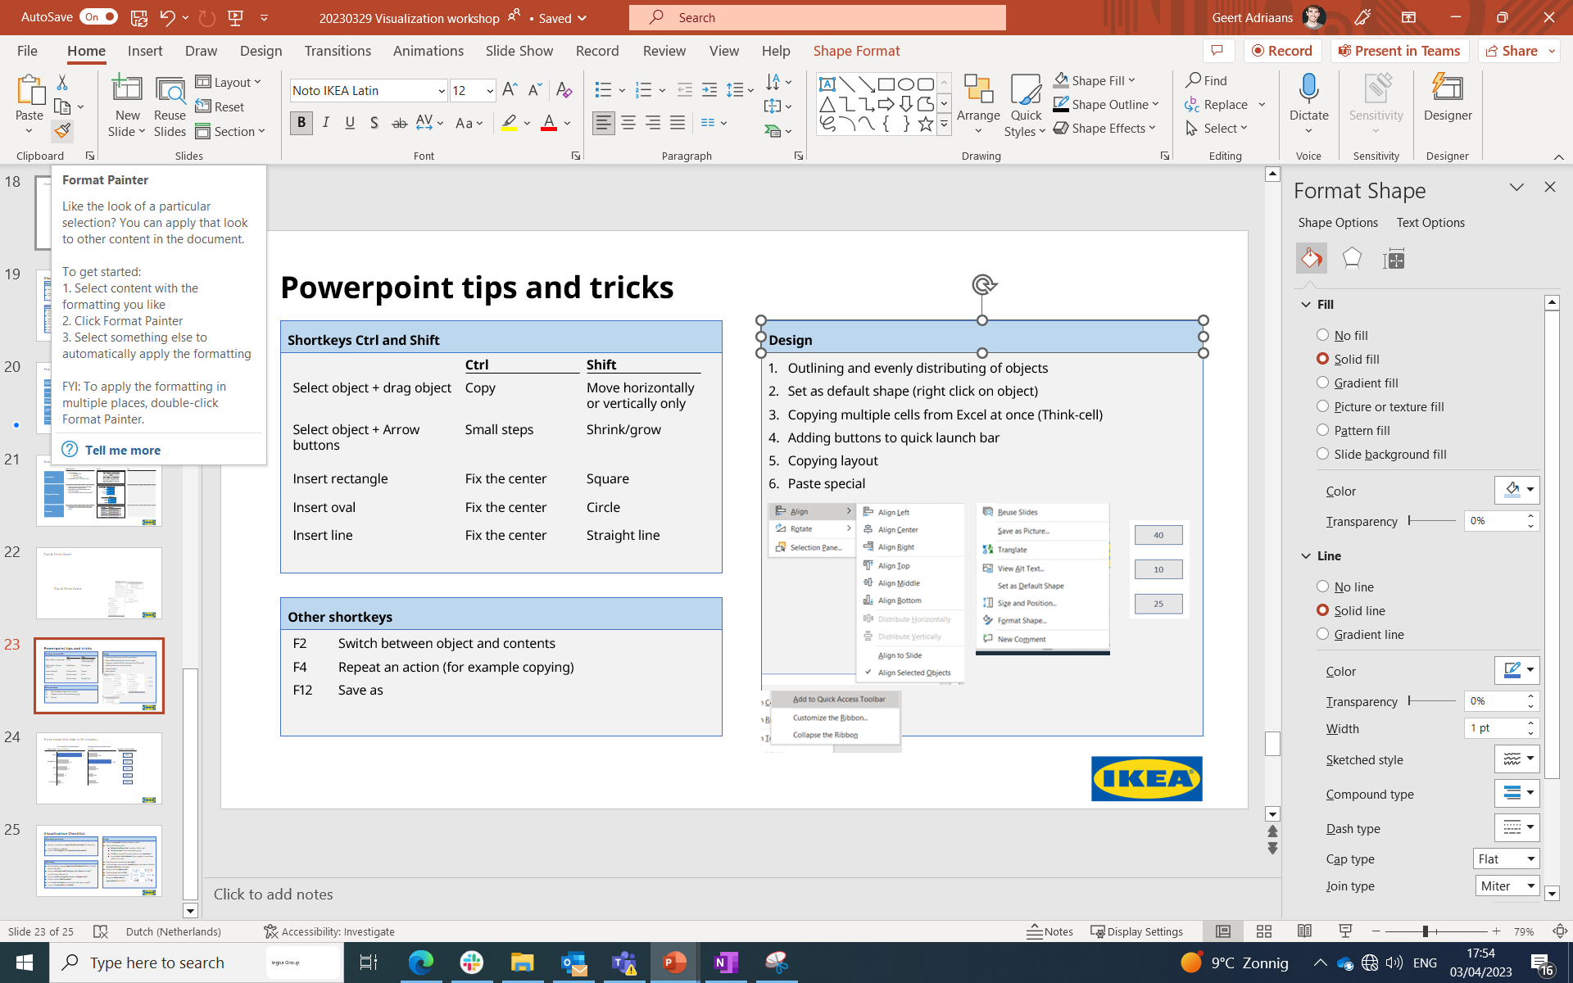
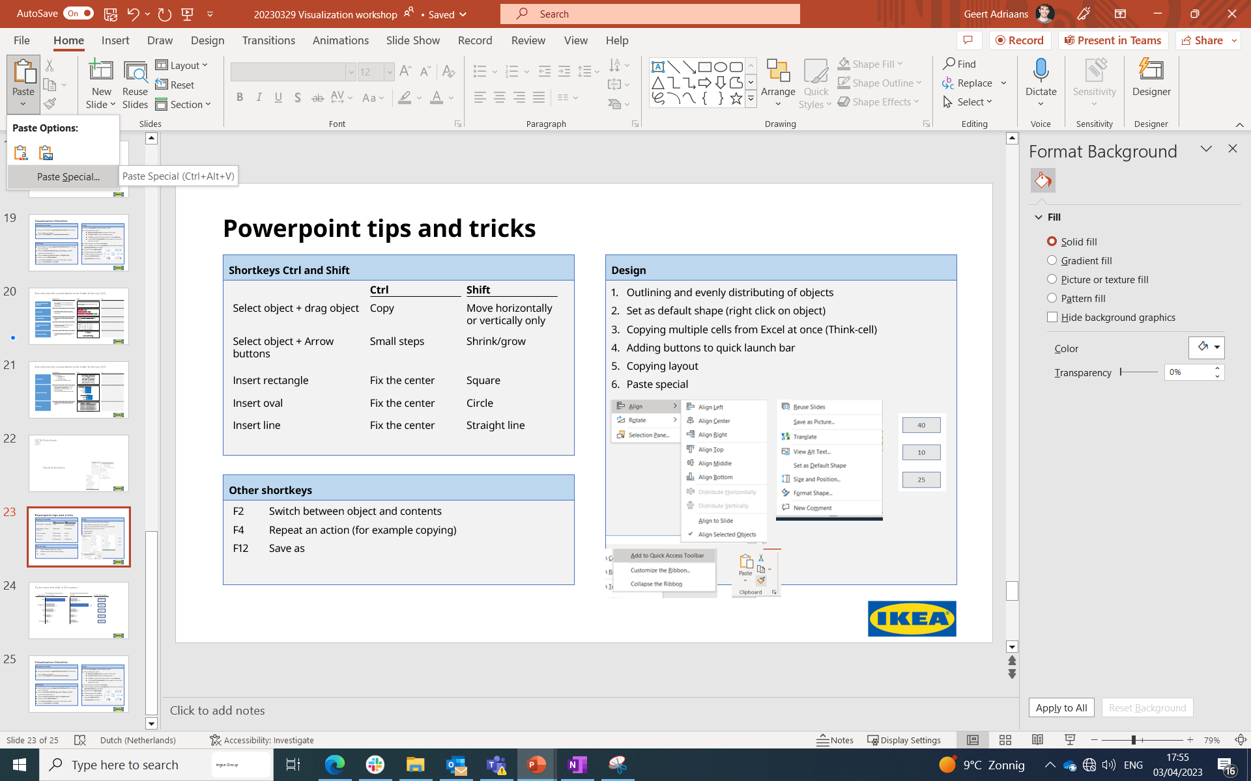
Powerpoint tips and tricks
Shortkeys Ctrl and Shift
Design
Ctrl
Shift
Outlining and evenly distributing of objects
Set as default shape (right click on object)
Copying multiple cells from Excel at once (Think-cell)
Adding buttons to quick launch bar
Copying layout
Paste special
Select object + drag object
Copy
Move horizontally or vertically only
Select object + Arrow buttons
Small steps
Shrink/grow
Insert rectangle
Fix the center
Square
Insert oval
Fix the center
Circle
1
2
3
Insert line
Fix the center
Straight line
Other shortkeys
F2
Switch between object and contents
F4
Repeat an action (for example copying)
4
5
6
F12
Save as

Slide 39
Create this slide in 10 minutes…
YTD Expenses by Department
(in USD millions)
Average Salary by Department
(in USD)
Department
Number of employees
Sales
40
Management
10
R&D
25
HR
25
Accounting
10

Slide 40
Visualization Checklist
Are your visualizations supporting the message? Or distracting from it? (Where is Waldo?)
Is your slide stripped of all redundant information?
Information processing
Graphs
Did you use graphs instead of tables or text?
Did you follow the rules?
Natural reading order: top-down, left to right
X-axis for time, Y-axis for everything else
No line in a graph if the information is not continuous
Logical start- and endpoint of your graphs (i.e. pie charts start at 12 o’clock)
Does the graph visualize the message?
Is the message supported by number(s) and can these number(s) directly be found on the slide?
Did you use the right graph?
Does the graph have a title?
Is clear for each component of
the graph which value is
represented (€, #, $, etc)?
Slide Design
Are the objects properly aligned and distributed? Both mutually and on the slide?
Are you consistent with font type, size, shape and color? Use font Noto IKEA Latin 12
Did you avoid too large font sizes and bright colors?
Did you use the IKEA template?
Is the color association correct (red = bad, green = good?
Is your slide peaceful and orderly?

Slide 42
Thanks!

